Slide 1

Partnerships for Innovation
How Banks Decide Which Fintechs to Partner With
Laurens Hamerlinck
Head of Fintech Venturing
June 2026 – AMSTERDAM BANKING FORUM

Slide 2
DISCLAIMER
This presentation is confidential and protected by intellectual property rights.
It may only be disclosed to other persons involved in Amsterdam Banking Forum 2026 who have a need to know basis, and are bound by confidentiality obligations.
Any reproduction of the presentation requires ABN AMRO’s prior written approval.
This presentation is shared for discussion purposes only, and is not intended to give financial advice. ABN AMRO does not make any representations or warranties that the information is accurate. ABN AMRO is not liable for any loss relating to this presentation.

Slide 3
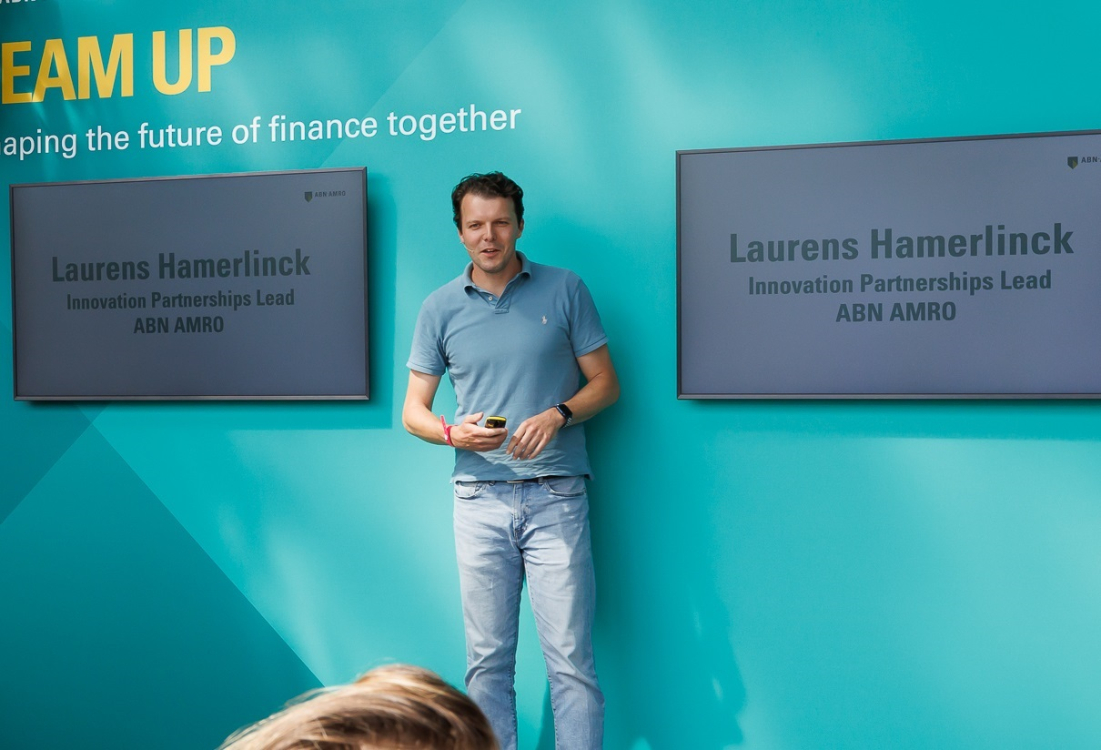
About me…
Background in change management
15+ years active in corporate innovation
Started in corporate venturing @ Dialogues Incubator
Joined ABN AMRO in 2013, part of the team team launching the Innovation Centre
Launched the ABN AMRO + Techstars Accelerator in 2021
Currently Head of Fintech Venturing fuelling fintech engagements, –investments and –partnerships, working closely with Motive Partners, Techstars and more

Slide 4










Two ways we innovate
Corporate Innovation
Inside-out
Corporate Venturing
Outside-in
Engaging with the Fintech Ecosystem
Supported by:
Tikkie
Zakelijk
BUUT
New10
Startup Accelerator for Early Stage Fintechs
Global Fintech VC and Private Equity Firm
ID&Pay
Achteraf betalen
Personal
Communication
Channel

Slide 5
ABN AMRO drivers for fintech partnerships
P&L / Business Development
fee/interest income
Intensify client relationship / increase client satisfaction (NPS)
Reduce capital costs, cost of risk, and OPEX
Support strategic insights, innovation and digital transformation

Slide 6
Partnerships 101: It only makes sense if…
ABN AMRO
Partner
VALUE &
SYNERGY

Slide 7


Slide 8
What value ABN AMRO can offer to fintechs
Partnership Mentality
Access to Capital and Customers
Clear Vision and Strategy
Strong Innovation Team & Partners
Startup Friendly
Deep Banking Expertise

Slide 9

So how to decide who to work with?
Not a single, black and white decision, at one point in time…
It is a process of validation…
Which often starts with our investment partners…
All the way through to Pilots and eventually Commercialization…

Slide 10

Our Fintech Approach
Part 1: Pipeline + Exposure
Dedicated fintech team
Supported by top tier investment firms
Upfront skin-in-the-game
Also allowing for more risk and co-development

Slide 11

Our Fintech Approach
Part 2: Process + Execution
Focus on finding synergies in the business
Start small, but with scale in mind
Proof of Value and –Execution through Pilots
Actively bridge culture gaps in the process

Slide 12

Proof of Value is key as this creates the foundation for (f)actual decision making
Team (in-)capable?
Bad or excellent at execution?
Technology does (not) move the needle?
Clients (don’t) like it?
(Lack of) partnership mentality

Slide 13

Case study: ABN AMRO + Convergent AI
Problem
New client-facing recruits suffered from low NPS, and bad FTR, and AHT
Unable to practice client calls
Current solutions (actors) are inflexible and expensive
Generic coaching
High sales and communication training costs across the bank
Solution:
Convergent AI (Techstars 2023)
AI training tool simulating real life client situations
Pre-trained on ABN AMRO call centre data
Co-developed with colleagues
Tailored feedback
Proven results:
    NPS at par or higher
    AHT at par or shorter
    FTR improved significantly
    Colleagues ánd coaches love the tool
    Full roll-out in 2026

Slide 14
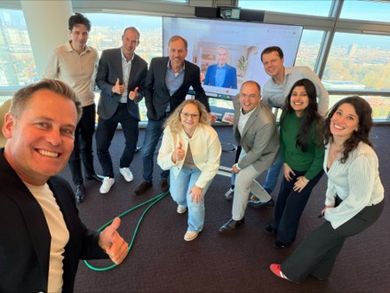
Why Convergent Ultimately Worked
Committed Business Sponsor
  A dedicated business sponsor ensured accountability throughout all project phases, especially during challenges.
Focus on Gathering (Financial) Proof Through Pilots
  Prioritizing pilots over presentations allowed for practical feedback and real-world validation of ideas.
Honest Expectation Management
  Innovation was approached as a learning process, managing expectations realistically without expecting instant success.
(Over time) Internal Believers as Ambassadors
  Internal advocates bridged cultural gaps and championed the project, driving its progress and success.
Notes:
Convergent ultimately succeeded because several critical factors were in place. A committed business sponsor remained accountable throughout the journey, even during challenging phases. The team prioritized pilots over presentations, focusing on real-world usage and feedback. Expectations were managed honestly: innovation was treated as a learning process rather than instant magic. Most importantly, a group of internal believers acted as ambassadors, pushing the project forward and bridging cultural gaps between the startup and the corporate environment. These factors enabled the partnership to survive friction and deliver tangible impact. The experience reinforced a key insight: successful partnerships depend less on perfect processes and more on resilient ownership, trust, and execution discipline.

Slide 15
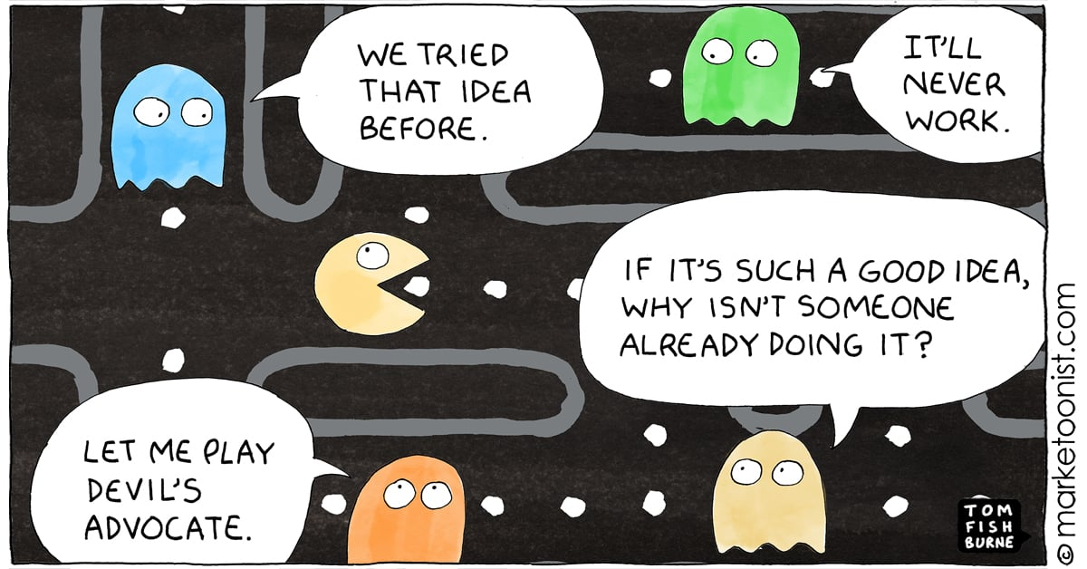
Be aware: your organisation might not be ready…
Not Invented Here
Underestimating Total Cost of Ownership
Startup Culture Gap
IT, Risk, Compliance, Security, or Legal running the business
No Budget BS
Corporate Arrogance (David & Goliath)
Sunk Cost Fallacy
Build It Your Own Bias building commodity software
Risk Aversion / Blame Culture

Slide 16
Conclusion: so how do we decide? We decide to TRY based on whether…
Our investment partners have conviction…
This is a solution worth trying…
There is somebody in the organization who cares…
The risk / reward ratio is healthy…
The proof (of a pilot) is compelling (both product/tech + team/execution)…
This is talent we want to work with…
+
This adds up to (f)actual decision making to implement, further co-develop or stop (and capture the learning!)

Slide 17

Some final thoughts…
Dare to try
Nurture that innovation culture
Don’t control, navigate!
Gather proof smartly
Failing = learning
Innovation is hard, have fun!

Slide 18
Thank you!
Laurens Hamerlinck
Head of Fintech Venturing
ABN AMRO Bank
Laurens.Hamerlinck@nl.abnamro.com

