Slide 1
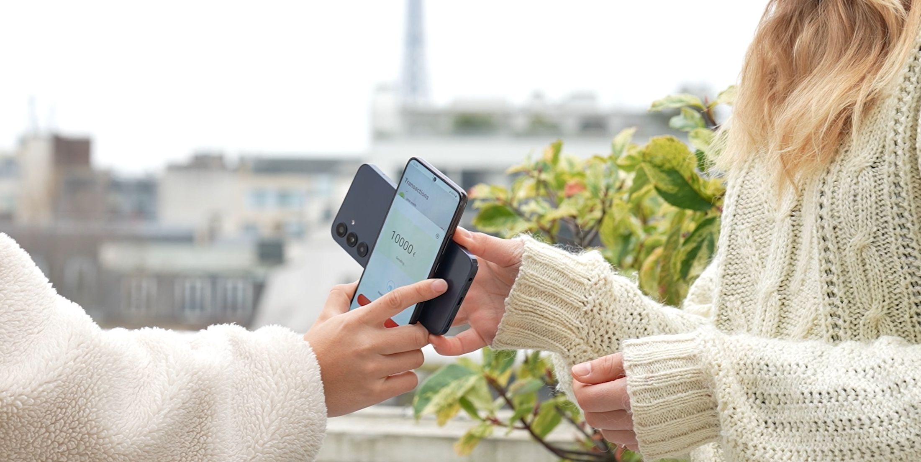

MONEYTAK®
Resilient cash wallet
Carrousel Digital 1/6/2026 www.carrouseldigital.com all rights reserved

Slide 2
E-cash
Work online
Work offline
Preserves global money supply
Resilient
Reliable
Easy to use

Slide 3


Work online
From App
Classical payments
Bank transfers
Debit cards
Instant payments
Access

Slide 4
Work online
transfers
To App
From App

Slide 5
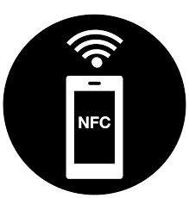
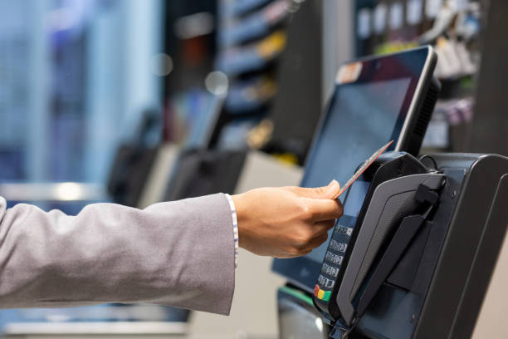
Work off-line
From App
To App
Є/$ Transfer
NFC

Slide 6
Work off-line
From App
To Apps

Slide 7
Preserves money supply
Є45
Є750
From App
To Apps
Є2,850
Є2,100
Є2,100
Є500

Slide 8
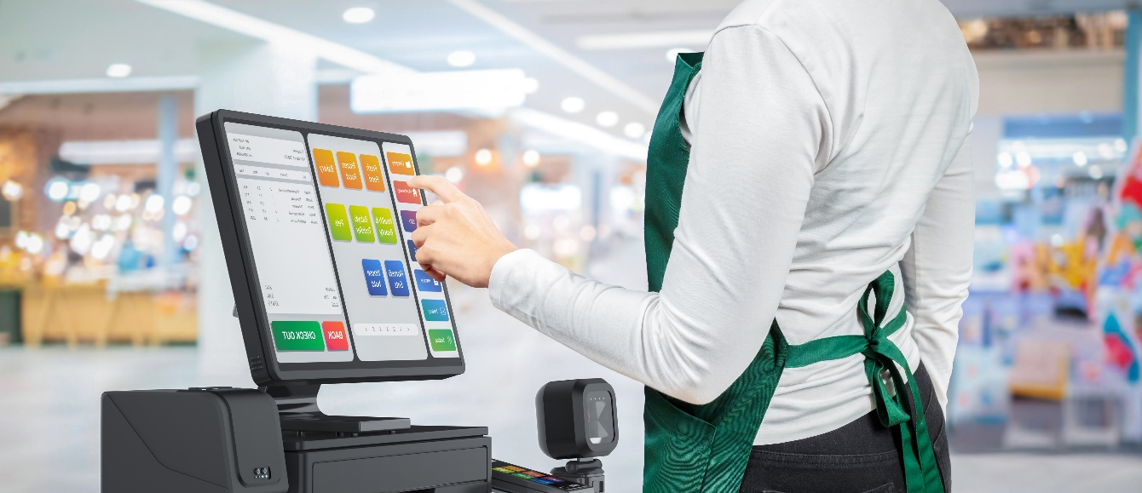

Work in shops
From App

Slide 9


Resilient to cryptographic prowess

Slide 10
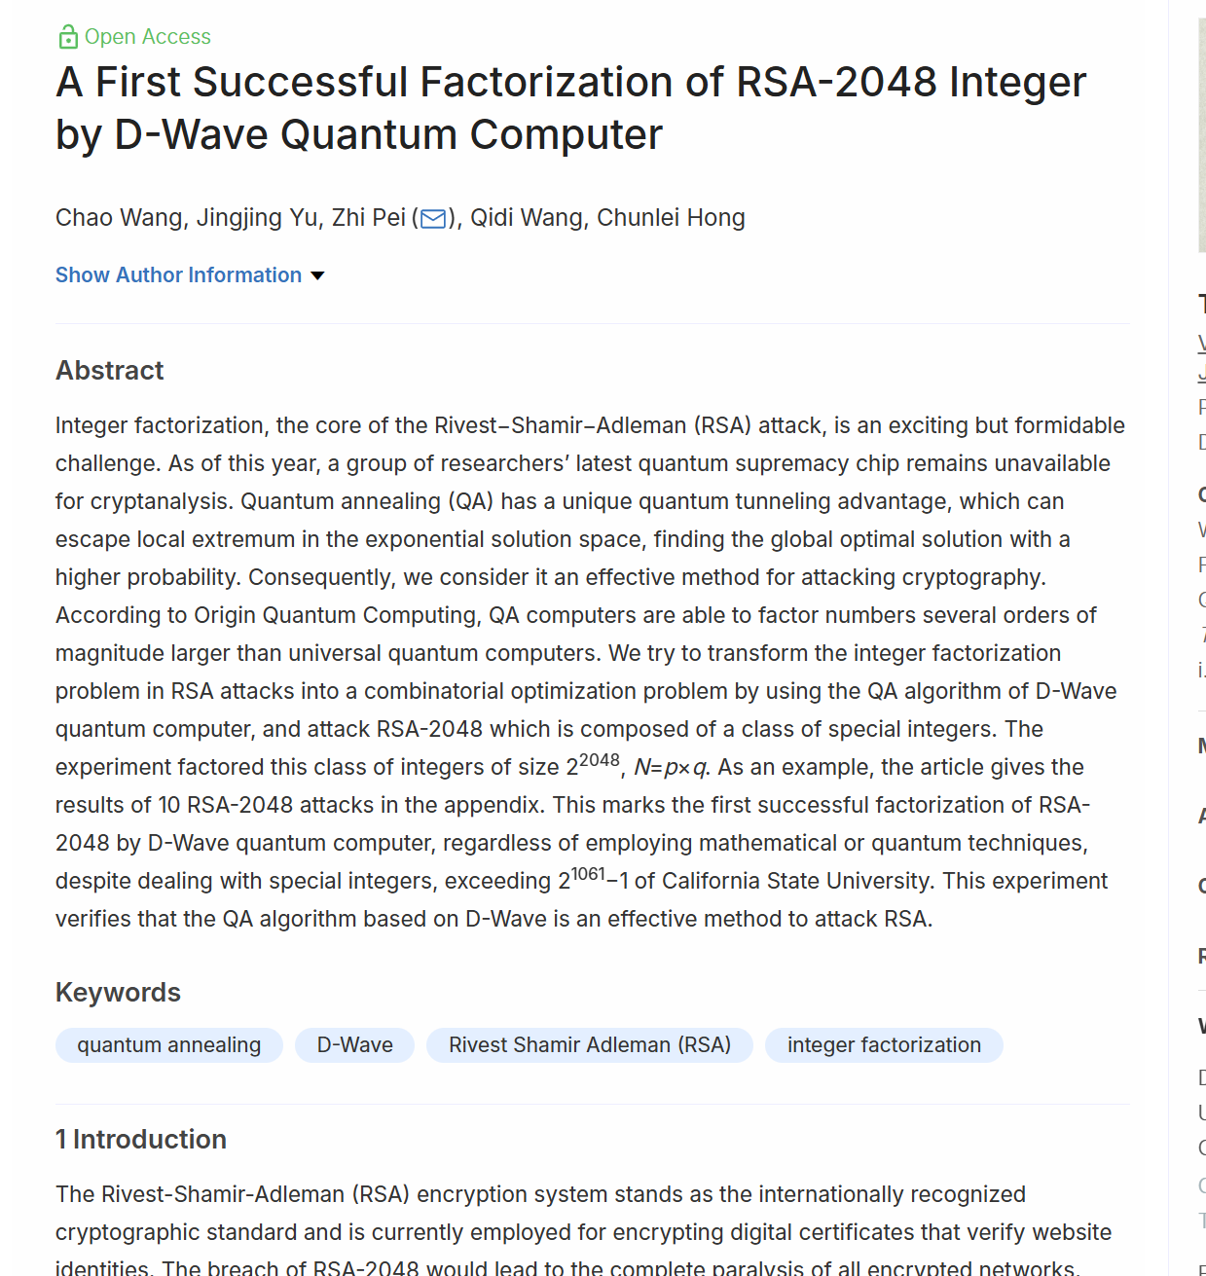
Quantum attacks threat
Source : TSINGHUA SCIENCE AND TECHNOLOGY, June 2025

Slide 11
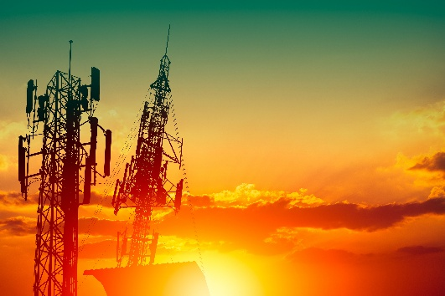
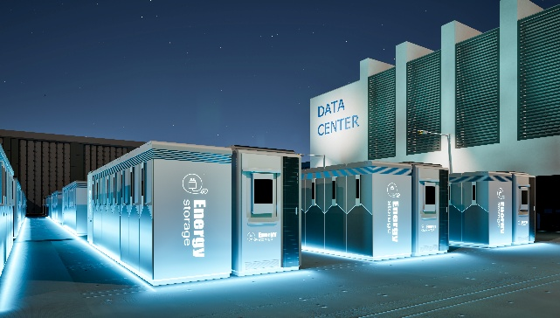
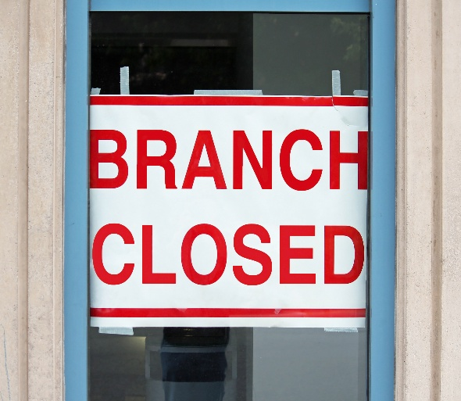

Resilient & Reliable

Slide 12
MONEYTAK®
Esay to use

Slide 13
Security Features
Block-Chain type security
  For offline transactions
  A signed message bearing all chained transactions transferring cash since an online transaction
  Sever can verify intermediary transactions without having been connected to the intermediary apps.
  Patents : US10643198B2, FR3080934B1, CN110443595A, KR20190126730A, EP3564914,IN201924017383, JP2019194858A, KR10-2929218, JP7617008B2 and more
Uses random hash signatures
  Quantum safe
  Uses 25 bits keys only
  Fits keys for 150 million users on 2Gb memory
  Patents : AU2020225314A1 , CN113811874A ,US20200351100A1, US11914754B2, US11914754B2, FR3092923B1, US20240089240A1, US20240089240A1, US20210176057A1, FR3104357B1, 2024112700243680 and more

Slide 14
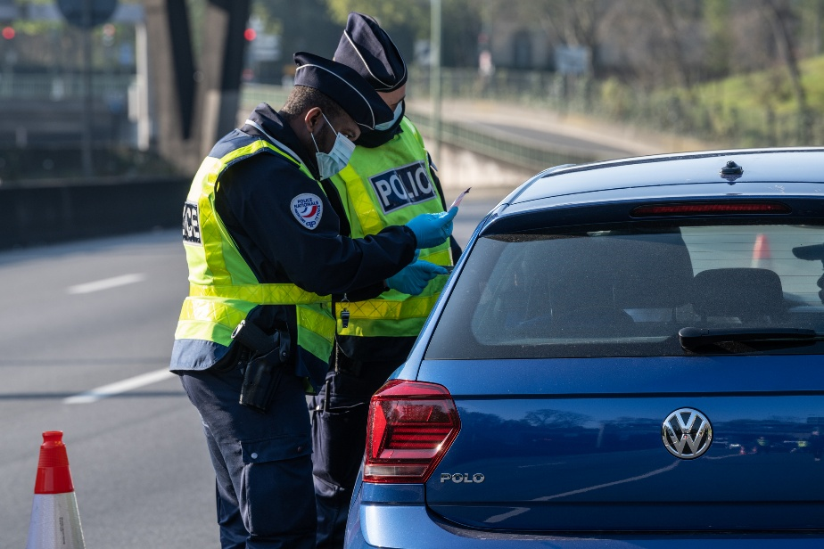
Moneytak® Id-Papers
Holds ID documents
Communicates online and offline for checking
Secured with random hash signatures

Slide 15

MONEYTAK®
www.carrouseldigital.com
Resilient cash wallet

