Slide 1
The Rapid Evolution of Banking Infrastructure: Achieving 'Continuous Innovation' is More Feasible Than You Think
June 2026

Slide 2
Trad-Fi vs. Fintech Perception
Fintechs are recognized for their speed of execution, exposing a vast gap in monetization ability vs operating as a fully licensed financial institution.
Result:
Market valuations for FinTechs are generally high, TradFi institutions are almost universally lower
Deposits, the foundation of banking activity, are moving to FinTechs
DXC has made a strategic and intentional decision to pursue the most challenging route—precisely because its difficulty creates a meaningful barrier to entry.
Our focus is on empowering entities that already operate as regulated financial institutions with established compliance infrastructure. Neither building this capability from scratch nor acquiring the operational expertise to manage a regulated depository institution is straightforward for a fintech. This dynamically positions us with distinct competitive advantages.

Slide 3

Trad-Fi vs. Fintech Reality
Legacy Financial Institutions
Heavily regulated
Pervasive image challenge
Spend years and immeasurable investment seeking, but failing to be more agile
Conversely, benefit from deposit trust
Technology debt exhibits high degree of complexity and customization
Risk averse, leading to lack of innovation
FinTech Competitors
Little or no tech debt
Non-regulated or partially regulated at best
Extort multiple levels of licensing that fall short of full banking license & corresponding trust
Dependent on a licensed bank – a regulated entity – to assume liability of deposits, issuance, and money transmission
Steep learning curve
Meaningful monetization probably depends on traditional products like lending

Slide 4

DXC Position on Building the Bridge
DXC Strategy Bridges the Gap
Legacy Financial Institutions
Invest. Invest. Innovate. Innovate more.
Develop tools for Trad-Fi clients to compete with and/or partner with FinTechs
Create business model incenting TradFi clients to leverage legacy infrastructure in partnership with FinTechs
Take long-term view that ultimate source of value is the regulated depository account...the source of funds, established compliance regime.
FinTech Competitors

Slide 5
Modernizing the core with HoganX
DXC AI enablement
1980
2025
• HOGAN •
45 YEARS OF HERITAGE NOW REIMAGINED WITH
• GrowthX •
40+
financial institutions
$5 trillion+
in global deposits
managed
$2.5 trillion+
in daily debits/credits
300 million
Demand Deposit
Accounts (DDAs)
45+ years
of heritage as a
banking platform
BRINGS YOU
Digital Assets
Programmable money & new asset rails
Revenue Expansion
Launch products faster. Monetize more relationships.
Agentic Banking
AI-powered servicing, advice & operations
New Revenue Engines
CoreIgnite
Real-time orchestration layer
HoganAI
Institutional knowledge for Hogan
HoganX
Cloud-native and AI Powered High Performance Ledger
INCLUDES
Three Pillars
HOGAN (or any) LEGACY CORE
FOCUSES ON
Built for the Next Era
Composable
Intelligent
Real Time
API-first integration
Embedded AI across workflows
Instant execution & settlement
GrowthX addresses the foundational barriers that slow banks down. Through embedded AI, real-time processing,
and cloud enablement, it creates the conditions for continuous, sustainable evolution.

Slide 6

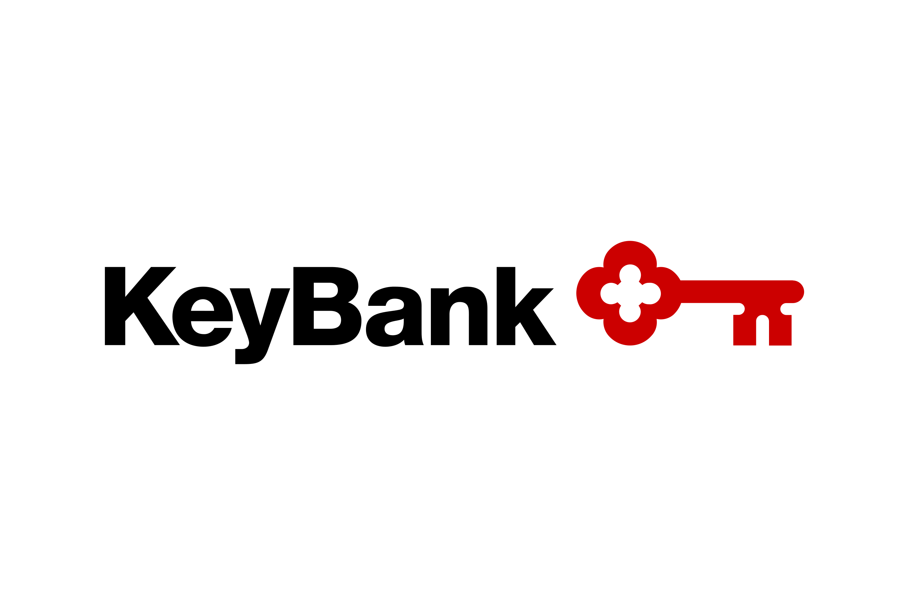











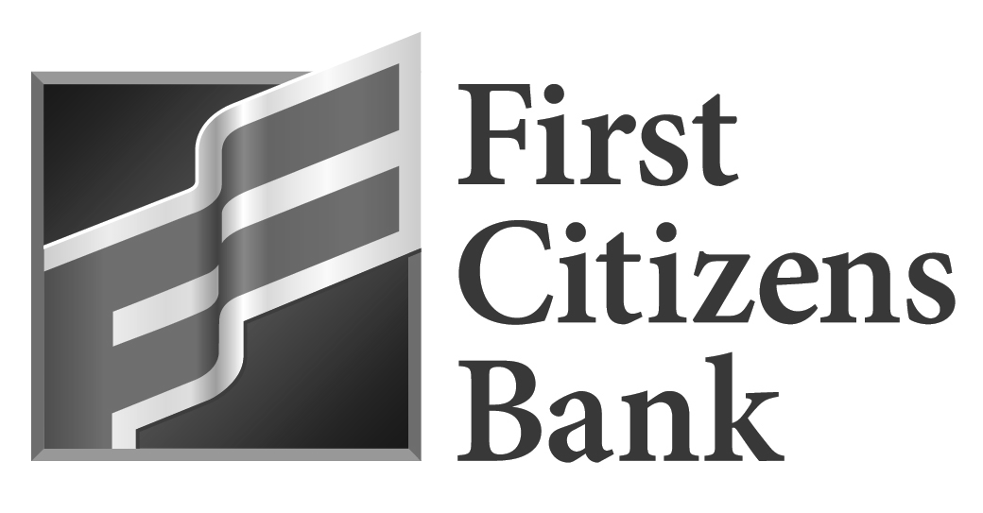
CoreIgnite overview
PILLAR 2: MONETIZE
CoreIgnite is built to monetize the bank’s existing core system. Capable of handling multiple financial domains, it serves as an orchestration and policy rules engine offering plug-and-play integration with partner categories and capabilities.
Banks, credit unions, brokerages with core-based infrastructure need access to next-generation financial product offerings.
Existing traditional and newer digital assets ecosystem bring new services, transaction volume, and revenue flows.
Payment Processors
AI LLMs
CoreIgnite
BNPL and Other Lenders
Crypto Exchanges
Data Aggregators
Crypto Custodians
Custodians
Stablecoin On/ Off Ramps
300mm DDAs on Hogan Today
Partners looking for Market Participants

Slide 7



Coreignite platform overview
PILLAR 2: MONETIZE
Integration Experience
CoreIgnite: Mesh Services Architecture
Orchestration Space
Gateway Security Plane
Core Microservices
Fusion App Hub
AI
Context
Unified API Gateway
Admin Service
Bank Core
Fusion App
SplitIt Context
Portal / Studio
JWT / HMAC / mTLS
Studio Service
Installment Loans
Fusion App
Space Resolution
Fusion Conductor
Payments Context
CoreFlow
Payments
Fusion App
Open APIs
Idempotency Control
Digtial Asset Custody
Fusion App
Digital Asset
Context
Policy Enforcement
Traffic Routing / Service Hub
Data / Analytics / AI
Light Core Ledger
Fusion App
Hogan Light Core
Ledger
Context
CoreIgnite
SDK
Data Plane
Application Data
Accounts & Transactions
Service Hub & Cache
Event Log / Analytics
Transaction Ledger
Data Recovery Tools
Governance Reports
Flow Optimization Reports
Investigative Tooling & Reports
Business Reports

Slide 8

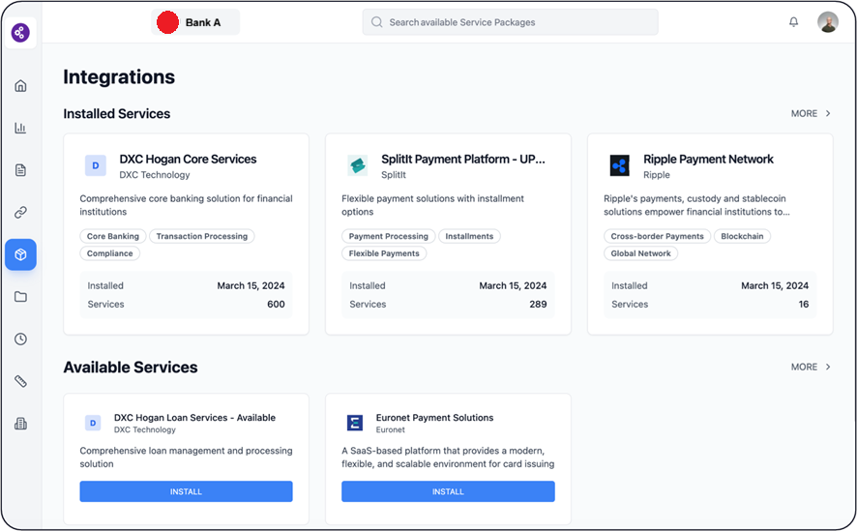
CoreIgnite APP MARKETPLACE
CoreIgnite Marketplace displays all available financial applications and services.
Users can install new applications, manage existing ones, and monitor their integration status from this central dashboard.

Slide 9
3 Functional Areas of Relevance
The path to tomorrow – leveraging a true Financial Services Operating System
Digital Asset Convergence
Current State
Infrastructure, budget, people capacity, higher priorities, and operational constraints
Target State
Infrastructure agility and capital efficiency along with scaled operational efficacy and optionality
Trusted AI Output
Real-time posting & data
Baseline Stack Requirements

Slide 10








THE PATH TO REAL-TIME
Problem Statement
THE CHALLENGES
HOGANX
NO REAL-TIME DATA
REAL-TIME, HIGH-PERFORMANCE POSTING
Real-time analytics (BI, AI) are critical, but a batch-based core cannot produce the event streams they require.
Sub-100ms posting at 100k+ TPS [in parallel]. Kubernetes-native, deployable on-prem, cloud, or hybrid. Every transaction produces an event stream for BI, AI, and risk.
LIQUIDITY RISK EXPOSURE
AI FEATURES BUILT IN
Without real-time balance visibility across channels, liquidity positions are stale and risk controls lag behind actual exposure.
Account health signals, transaction anomaly detection, and predictive balance forecasting native to the ledger.
HARD TO BUILD NEW PRODUCTS
ACCELERATED PRODUCT DELIVERY
Extracting data from legacy core is slow and complex. Every new initiative pays a "core tax" in integration effort.
Modern API-first architecture. New products plug in via REST APIs and Kafka event bus instead of legacy integration cycles.
COMPETITORS ARE PULLING AHEAD
AI BUSINESS RULES ENGINE
Challenger banks ship faster every quarter while legacy players spend more just to maintain the status quo.
Built-in engine for limits, fees, and compliance triggers. Business teams configure rules via UI with no code changes or release cycles.

Slide 11
Problems solved by hoganai
HoganAI · Problem Statement
Tribal Knowledge
Critical business logic embedded in client branches exists nowhere in formal documentation
Institutionalized Knowledge
Hogan knowledge captured, contextualized, and continuously accessible
Aging Workforce
Deep Hogan expertise is concentrated in a shrinking pool of senior engineers approaching retirement
Talent Continuity
Delivery no longer dependent on a handful of senior engineers
HOGANAI
Slow Time-to-Market
Tangled dependencies and accumulated technical debt drag every change cycle
Accelerated Development
Faster impact analysis, safer changes, and shorter release cycles
AI Constraints
Goldmine of transactional data not wired to AI, generic models can't replicate Hogan operational intelligence
AI Banking Enablement
Hogan operational intelligence becomes consumable by AI-driven workflows

Slide 12
HOGANX REAL-TIME POSTING
Every financial transaction is processed in real time, producing an immutable, double-entry ledger, handling the full account lifecycle: balance checks, holds, multi-currency FX, interest accrual, fee calculation, and event-driven integration.
CORE
POSTING
TRANSACTION
MANAGEMENT
RESILIENCE &
INTEGRATION
Hoganx AI-ENABLED BUSINESS RULES ENGINE
Business decision logic externalized from application code into a governed, auditable rule engine. Rules apply across the transaction lifecycle: real-time validation, post-transaction actions, and account-level policies.
RULE
EXECUTION
GOVERNANCE
& COMPLIANCE
OPERATIONS
& AI

Slide 13
OUR APPROACH
OUTCOMES
Uplift current instance of your core
Deploy Light Core Ledger
REAL-TIME, HIGH-PERFORMANCE POSTING
Instant availability of posted account balances and transactional data for all channels and downstream applications
Step 1
Step 2
AUTO-RECONCILED, SYNCHRONIZED SOURCE OF TRUTH
Business Rules and Transaction data are continuously synchronized and reconciled between the light core ledger and the backend.
  Deploy HoganX to facilitate accelerated development to:
  Externalize Business Rules Layer
  Preserve legacy customizations
  Continue to maintain an evergreen Knowledge Base
  for future development
  Deploy Light Core Ledger to:
  Manage Business Rules and Product setup outside of the mainframe
  Provide instant ledger visibility without querying the backend core
  Provide Out of the box REST API and Event Driven Connectivity
ACCELERATED PRODUCT DELIVERY
Modern API-first architecture. New products plug in via REST APIs and Kafka event bus instead of legacy integration cycles.
BUILT IN AI FOUNDATION
Account health signals, transaction anomaly detection, and predictive balance forecasting native to the ledger.

Slide 14
Tokenized Deposits: CoreIgnite Approach
Monetize Deposits
Bank decides operational scope. Suggested sequence of initial scope and expansion (without commercial overlay):
INTERNAL ONLY
SELECT PERMISSIONED COUNTERPARTIES
CONSORTIA AND CORRIDORS
SELECT COMMERCIAL CUSTOMERS
TOKENIZED RWA MARKETPLACES
Stage 1
Stage 2
Stage 3
Stage 4
Stage 5
Realize efficiencies and new margin through orchestration, transparent to customers
Transact with select counterparties as transfer or spend venues. Configure arbitrage opportunities
Participate in multiple consortia for inter-bank efficiencies across different business verticals
Productize next-generation premium services to commercial clients
Diversify treasury rails of existing instruments to on-chain version where margins or revenue are to be gained
Orchestration Foundation
Controlled interoperability layer above existing deposits infrastructure
Preservation of source of truth semantics and reconciliation integrity
Maximizing reuse and creating a connected business operation model
Programmable movement within policy-controlled operational corridors

Slide 15
Digital Assets: Defining Commercial objectives
Monetize Deposits
Digital Assets unlock multi-pronged benefits. Defining the commercial objectives helps define operational priorities.
TREASURY
TREASURY
Liquidity orchestration
Working Capital Optimization
FX SAVINGS
COMMERCIAL
PAYMENTS
COMMERCIAL
PAYMENTS
Embedded Payment orchestration
Share-of-wallet Expansion
COREIGNITE DIGITAL ASSETS
DEFEND
DEPOSITS
Deposit Engagement Engine
Core Funding Protection
CROSS-BORDER
VELOCITY
DEFEND
DEPOSITS
CROSS-BORDER
VELOCITY
Payment and Corridor Flow Engine
Settlement Speed Ladership
FX SAVINGS
FX Arbitrage Engine
Cost takeout and Savings

Slide 16
Digital Assets with CoreIgnite
CoreIgnite in Digital Assets
Orchestration flows with account and funding model nuances handled
Integration Target Landscape
1 flow unlocks many providers
Tokenized deposits issuance, settlement & management
CoreIgnite
Cari Network
Acme Co
(Tassat)
Source of Truth Systems
Fusion Apps
Flows
Service Provider Fusion Apps
1:1
Cari Tokenized Deposit
Treasury
Treasury
Tokenized Deposit
Flow
Acme CoTokenized Deposit
Crypto custody and trading
1:1
Ripple Crypto Custody & Trading
Customer Deposits
Customer Deposits
Crypto Custody
Flow
Ripple Custody
Other Co
(Coinbase)
OtherCo Custody & Trading
Operational Deposits Subledgers
1:1
Operational Subledgers
Payments
Flow
Ripple Payments
Euronet Payments
Cross-border and local payments
Model bank modules built once for a pipeline of outcomes
Ripple Payments
RLN
Managed services to providers

Slide 17
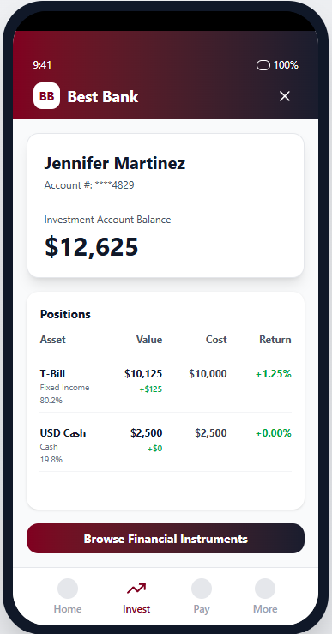
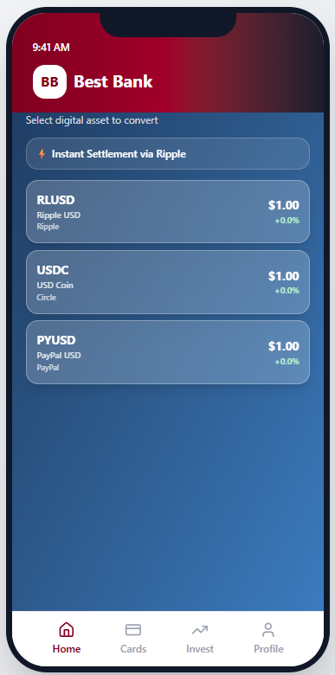
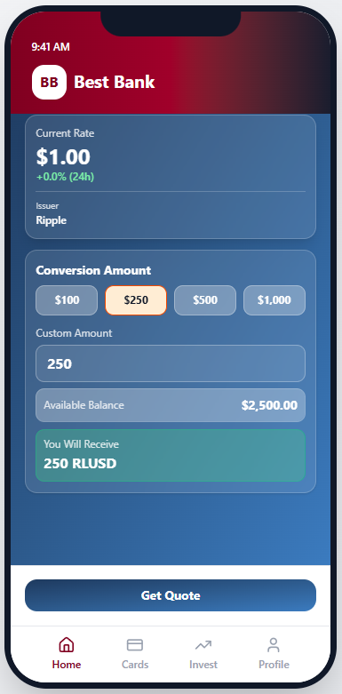
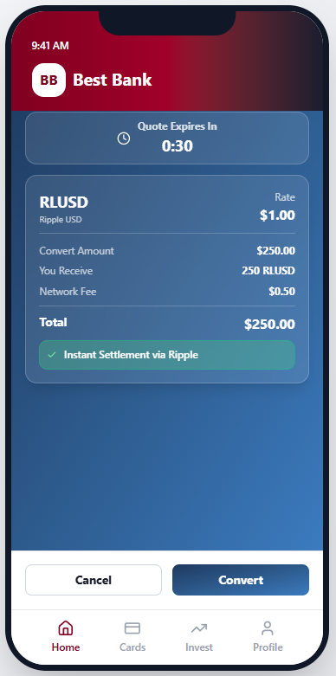
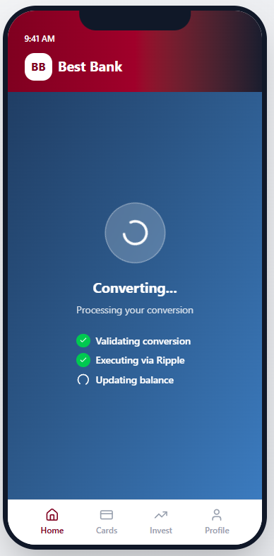
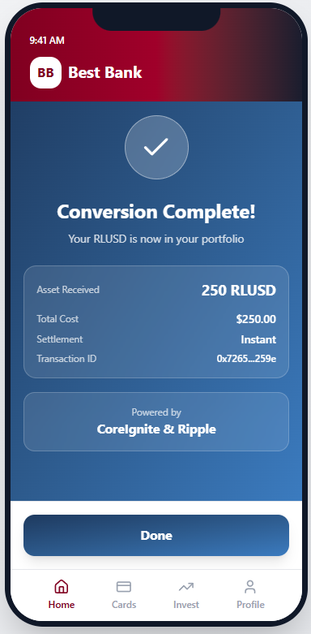
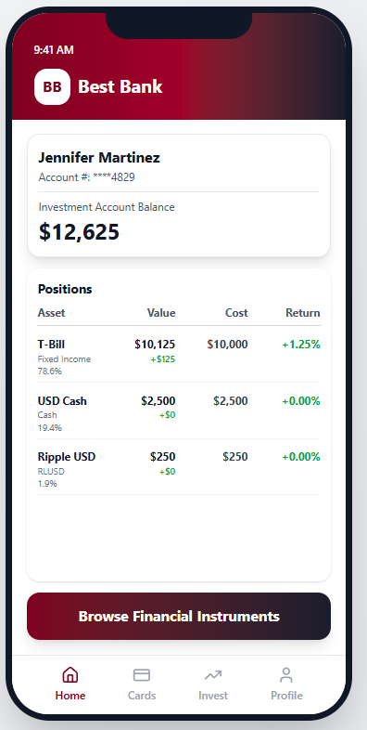
Stablecoin for the retail bank
Stablecoin operations for retail and commercial clients
Bank customer has a “Cryptocurrency account”.
(Commercial/HNW: on-chain ; Retail: Off-chain)
User clicks “Browse”
User selects the stablecoin they want to purchase. The asset available in the bank’s pre-funded and pre-converted omnibus account are shown as available.
User selects the amount of fiat currency they wish to convert into the selected digital asset,and requests quote. This amount is withdrawn from the checking account (with the ability to set min and max limits)
CoreIgnite passes the purchase request to Ripple which sends back a quote with fees breakdown(which may be flat or varying depending on the institutional relationship). The user submits the quote for purchase
CoreIgnite and Ripple orchestrate stablecoin transfer into the user’s cryptocurrency account. Ripple enforces bank-configured policy and rules at the time of performing the operation
User gets confirmation of executed purchase
User sees stablecoin balance in the bank’s naïve portfolio view. The experience can be fully bank-themed and controlled by the bank via configuration in CoreIgnite.
Map APIs, and drop a widget into your front end to enable an end-to-end flow

Slide 18
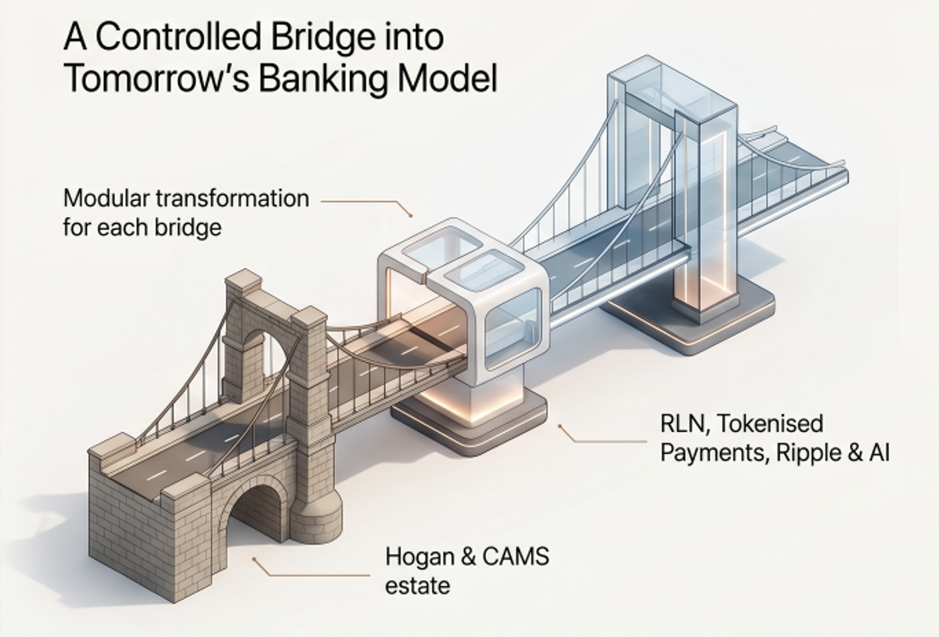
Continuous Innovation
DXC is engineering the bridge to sustainable innovation and the foundational flexibility to adapt to the future
AI, DeFi, and real-time, 24/7 settlement, beyond
Modular, incremental transformation for each section of the bridge
Each incremental expansion running on foundation of GSIB class operating system facilitating scale, resiliency, and efficiency
Legacy infrastructure is the anchor for evolution

Slide 20
Digital assets: CoreIgnite Approach
Monetize Deposits
Stage | Key Benefits | Core Operations
Infrastructure & Compliance Setup | Regulatory clarity, reduced future rework, foundational tech readiness | Establish APIs and smart contracts required, standards; secure regulatory approvals (banking charter alignment, AML/KYC integration); define token legal structure (deposit liability representation)
Issuance & Custody Framework | 1:1 fiat-backed trust, seamless on/off-ramps, customer confidence | Build mint/burn mechanisms tied to core banking ledger; integrate digital custody; implement real-time reserve attestation; connect to existing payment rails for fiat conversion
Programmability & Product Integration | Faster settlements, automated compliance, new revenue streams | Deploy programmable payment logic (escrow, conditional release, auto-sweeping); enable intraday or instant interbank settlement; integrate with trade finance, payroll, and treasury products; offer API access for corporate clients
Interoperability & Scale | Network effects, reduced counterparty friction, market leadership | Join or establish shared settlement networks with other banks, consortia; adopt common token standards for cross-platform compatibility; expand to cross-border corridors; continuously optimize gas/transaction costs and throughput

