Slide 1

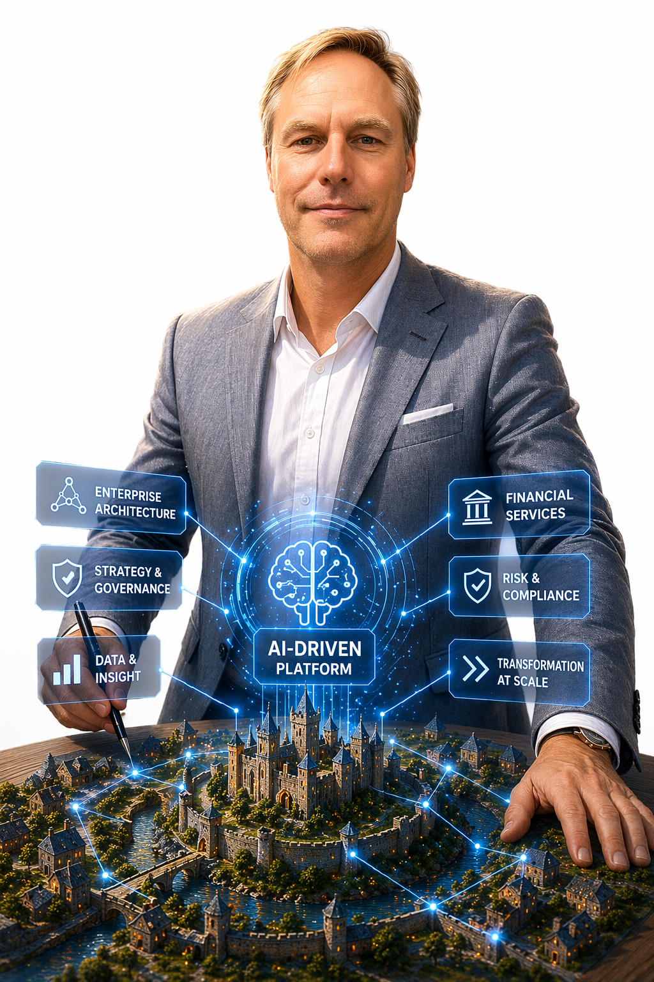
Intelligent Centralisation:
How AI-Driven Platforms Unify and Optimise Enterprise IT Infrastructure
Speaker: Lex Veltman
Head of Enterprise Architecture FSI
at NTT DATA

Slide 2
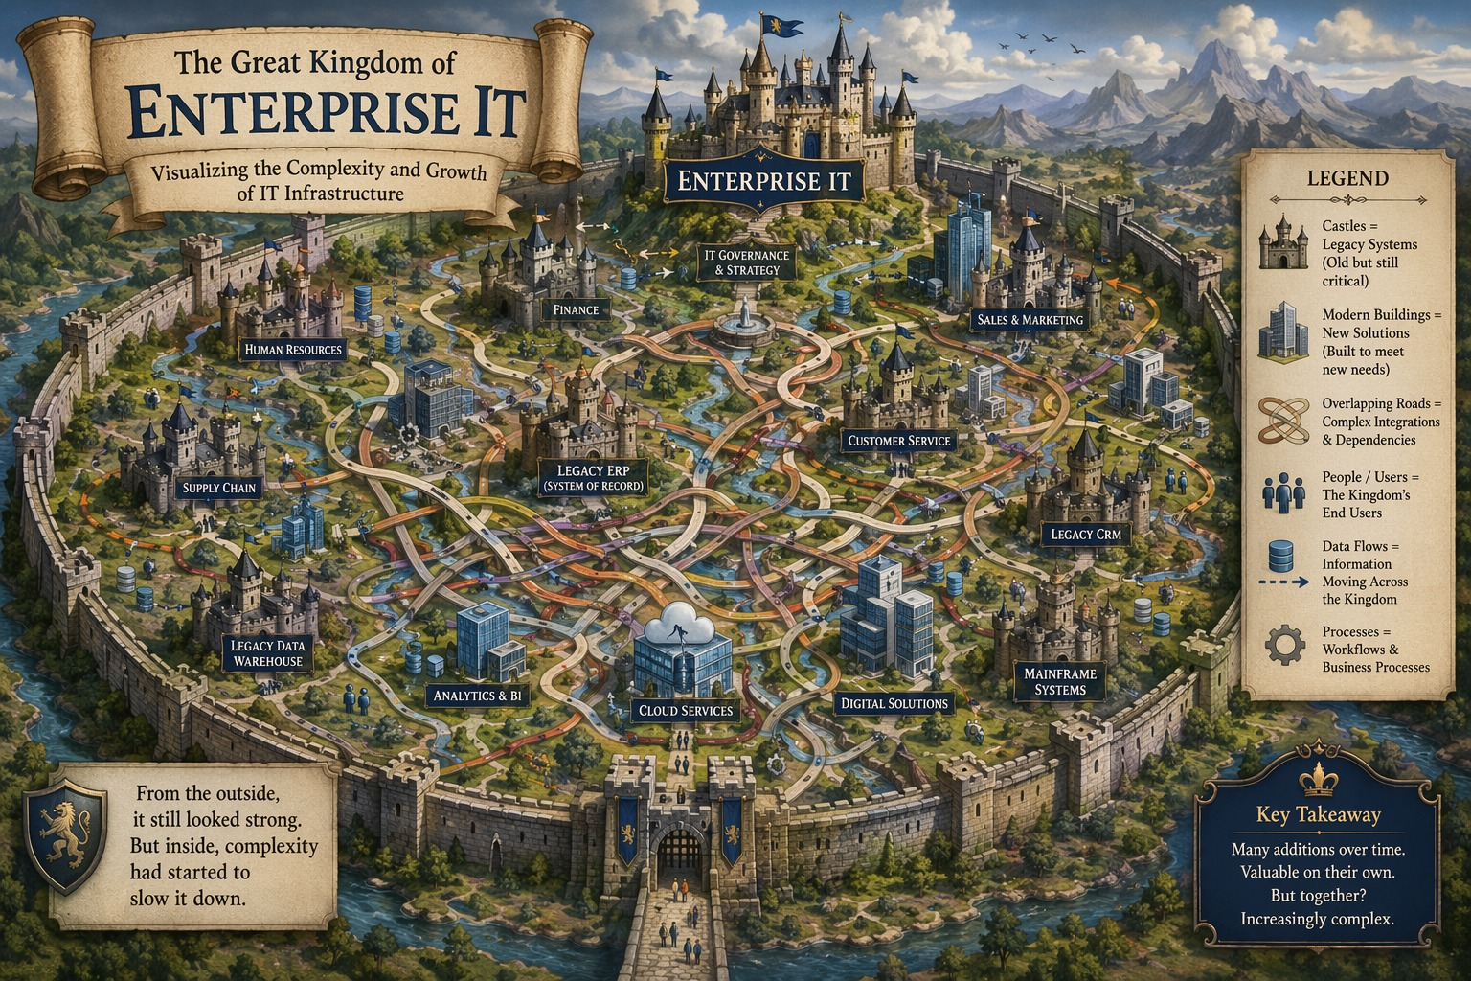

Slide 3
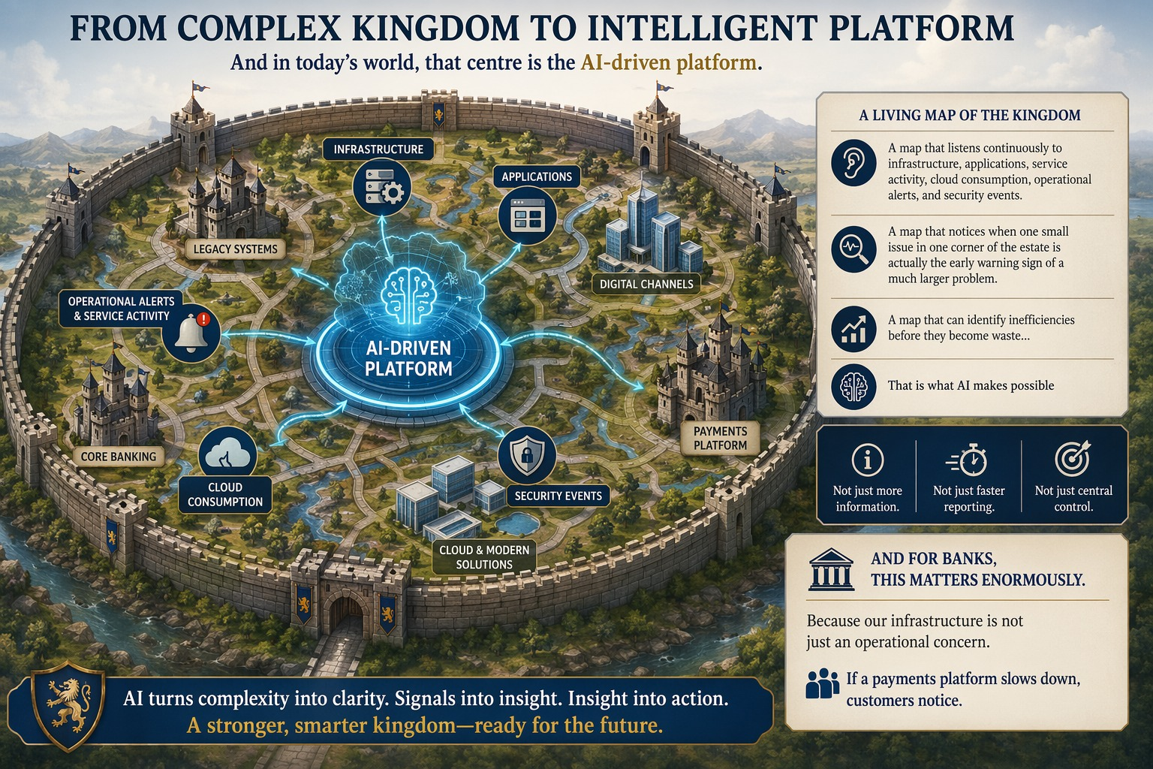

Slide 4
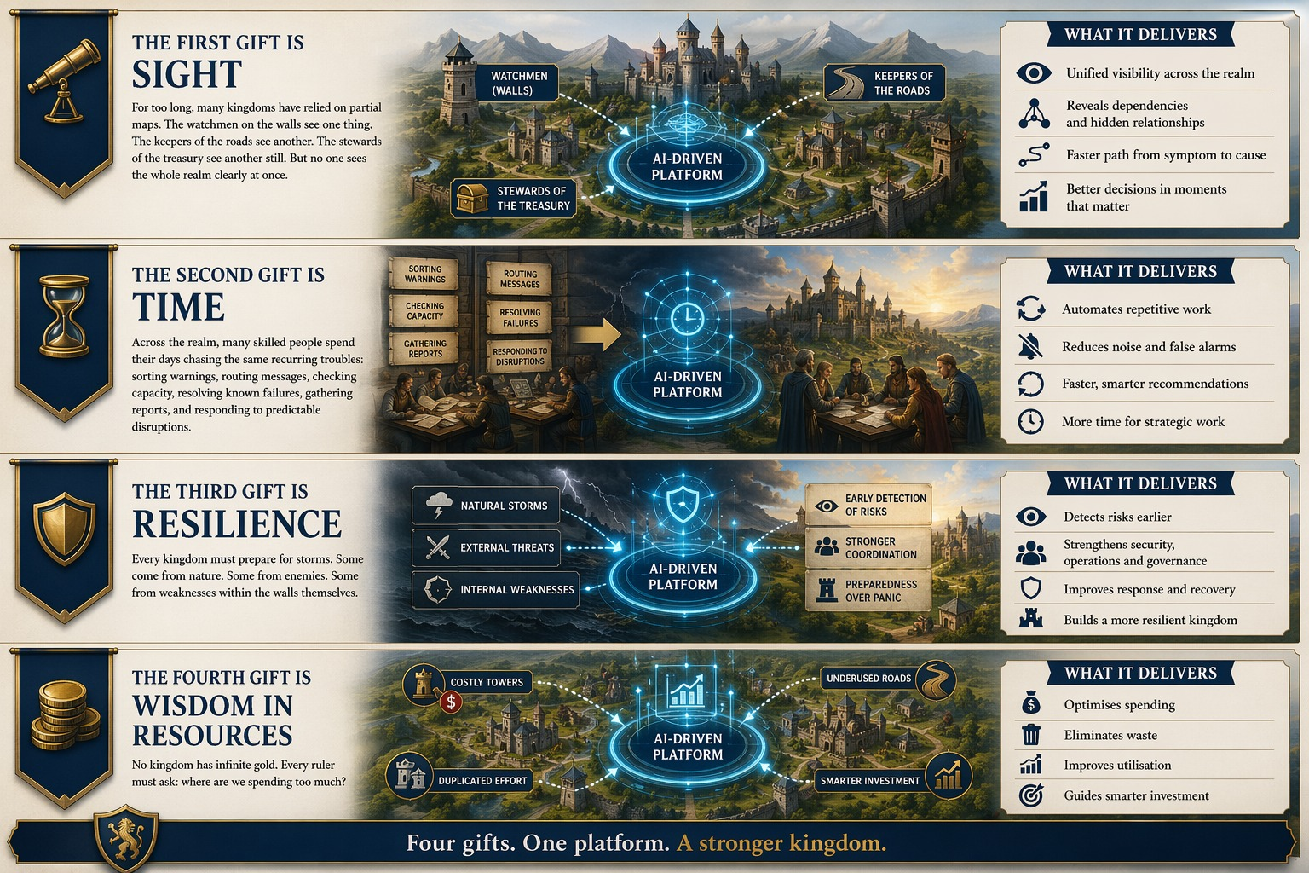

Slide 5
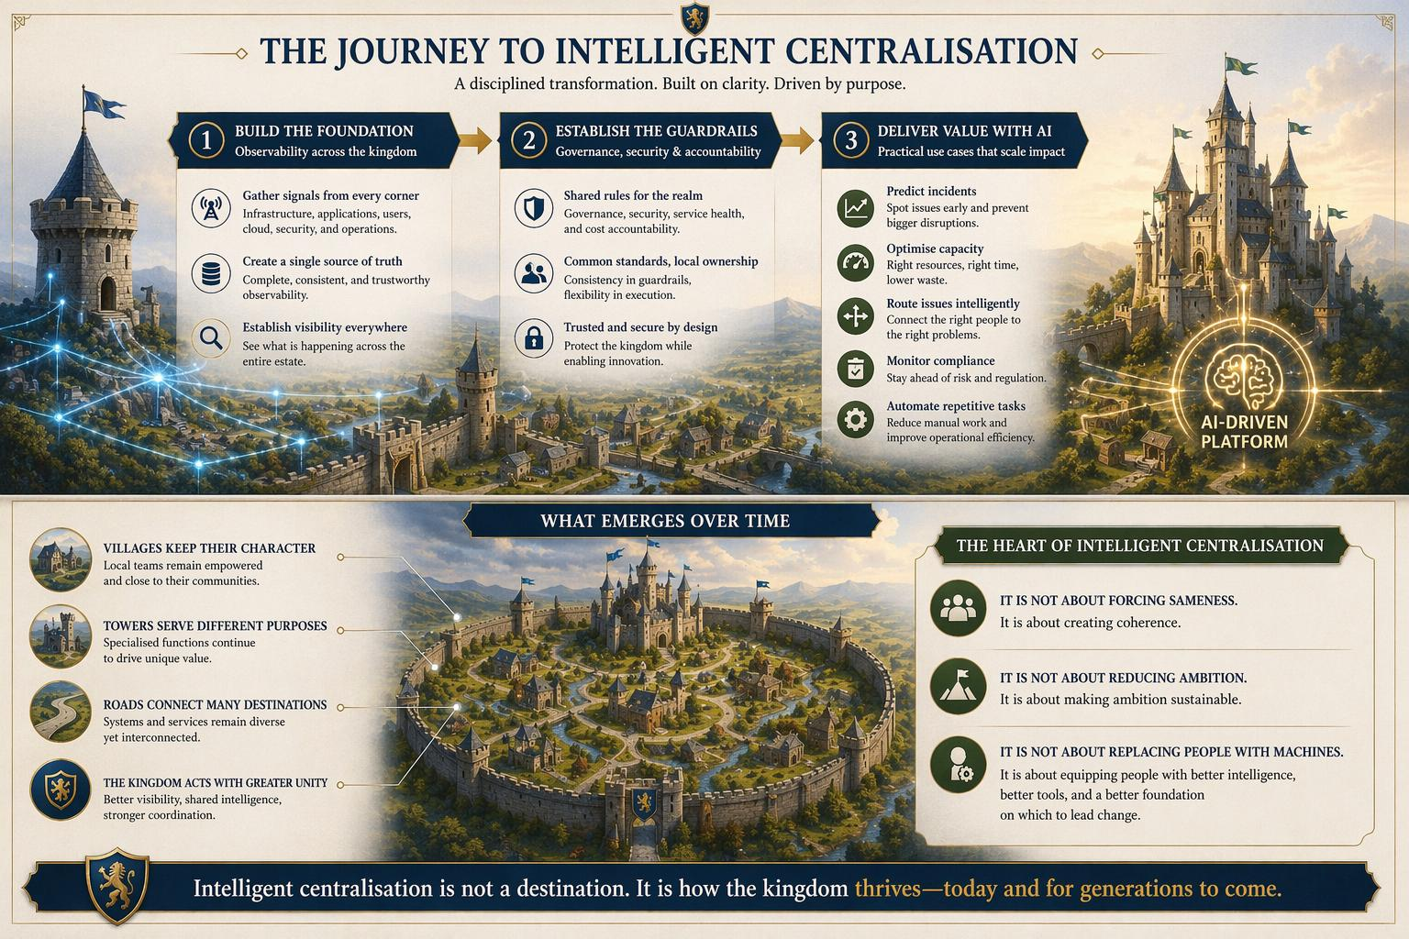

Slide 6
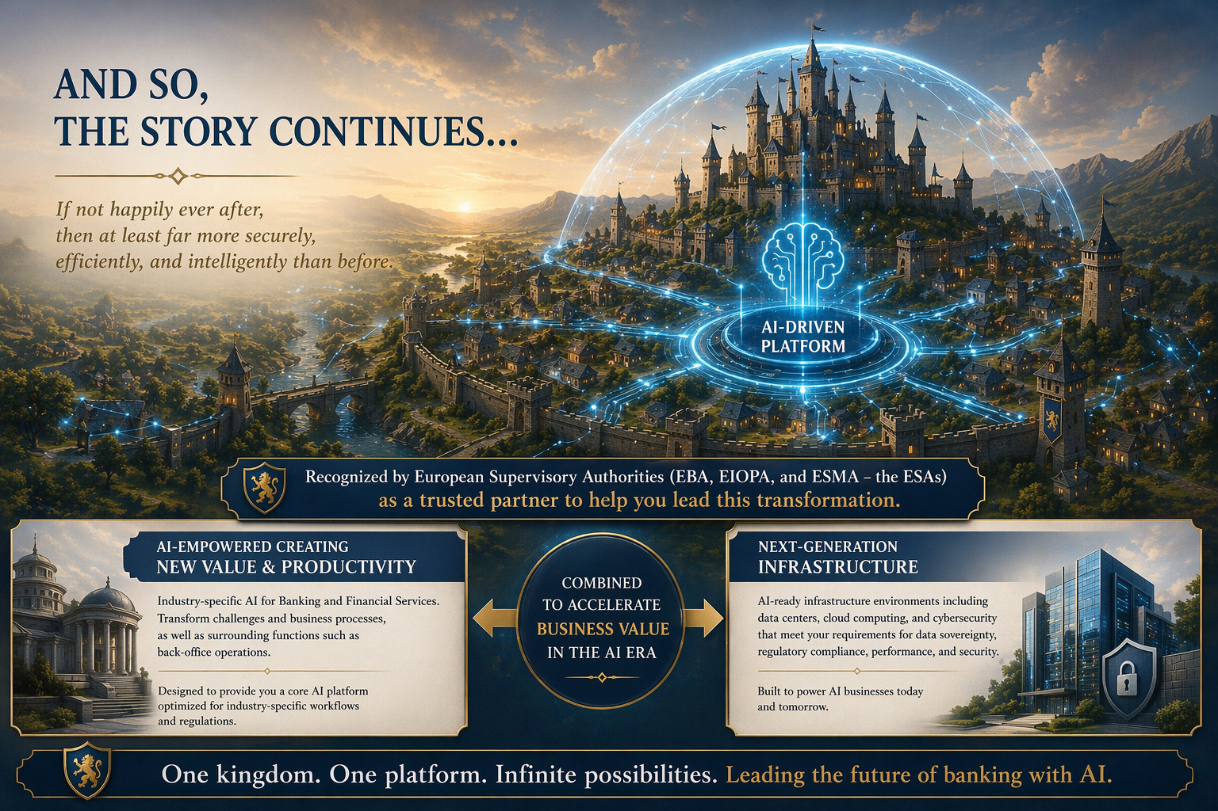

Slide 7
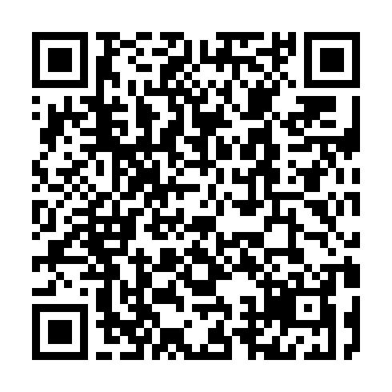
2026 Global AI Report
A playbook for AI leaders in Banking
and Financial Services
Thank you

