Slide 1

You Can't Transform What You Can't See
Amsterdam Banking Forum | From Strategy to Execution
Amsterdam, May 2026 | Oren Rosenzweig, Co-founder & CPO, Cobalt
Notes:
Hi, I'm Oren Rosenzweig, co-founder and Chief Product Officer at Cobalt.
In the next few minutes I'll argue that the bottleneck in bank transformation today is not strategy, not tech selection, and not people. It's visibility.
You can't execute on what you can't see.
Then I'll show you how Cobalt solves that.

Slide 2



Banks are on a Transformation Journey
01
02
03
Improve Business Process Efficiency
Introduce Agentic AI
Modernize legacy infra
A typical bank has thousands of business processes. Most are poorly documented or monitored for performance
Agentic AI is here with many powerful products on the market capable of improving customer satisfaction and enterprise efficiency.
What’s not clear is where to start, and what integration looks like
Reduce vendor lock-in, decommission out-of-use products, migrate from unsupported legacy SW, and integrate systems post M&A
Notes:
Every bank is running some version of three programs in parallel.
One: improving the efficiency of existing business processes.
Two: is introducing AI
Three: modernizing legacy infrastructure. Decommissioning unsupported software, reducing vendor lock-in, integrating post-M&A.
Different objectives but all hit the same walls

Slide 3
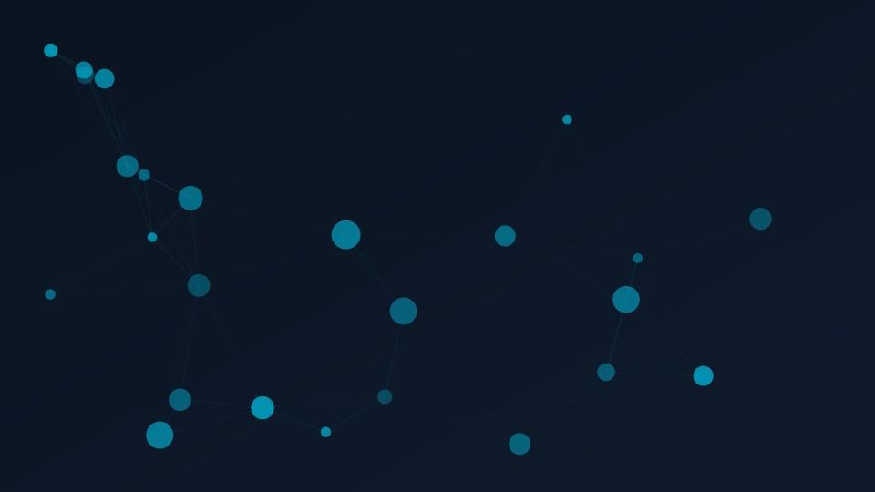
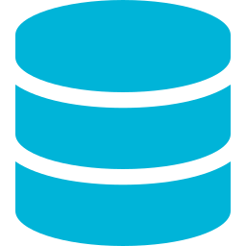


Why Transformation
Stalls
Business processes span multiple layers:
Core Systems
Applications, legacy platforms, vendor systems
Communication
APIs, messaging, event streams
Execution
Batch jobs, scheduled processes
The Impact
Slower execution of strategic initiatives
Weeks of manual tracing for every change
Higher risk in every transformation decision
Hidden dependencies surface
Inability to confidently deploy AI at scale
No way to calculate true blast radius
Notes:
Pick any of those goals and ask your team a simple question: which systems will be touched?
You'll get an answer that's operationally useless. Because there is a gap between the diagram on the wall and the runtime reality
Every change requires weeks of manual tracing.
It’s all a visibility problem.

Slide 4






What Successful Transformation Requires
A shift from static documentation to a living model of the enterprise
EXECUTIVE VIEW
EA / TECHNICAL VIEW
Faster, Confident Decisions
Real-Time Architecture View
Full Visibility Across the Org
Automatic Discovery
Reduced Execution Risk
Instant Impact Analysis
Notes:
So -- To unblock execution, three things have to be true.
1. The view of the architecture has to be real-time. What the systems are actually doing right now.
2. It has to be generated automatically.. Eliminating interviews and manual work
3. It has to be operational, Meaning you can use it to make a decision.
So to summarize it is a shift from static documentation to a living model of the bank.

Slide 5
HOW COBALT WORKS • LOGICAL STACK
The Cobalt stack - data feeds the crawler, which builds intelligence, which powers use cases
01 • USE CASE
02 • USE CASE
03 • USE CASE
Improve Business Process Efficiency
AI AGENTIFICATION
Modernize legacy infra
LAYER 2
Systems Intelligence - the living architecture map
LAYER 1 • CORE ENGINE
Cobalt Semantic Crawler
LAYER 0 • DATA SOURCES
CMDB
Logs
Code
APM / Telemetry
APIs
Docs
No agents installed • no credentials required • read-only access • metadata only
Notes:
So how do we do it?
Cobalt reads the artifacts that already exist in the bank’s environment, logs, code, telemetry
crawling through them to reconstruct the topology and every business process running across it.
Let me show you what that looks like.

Slide 6
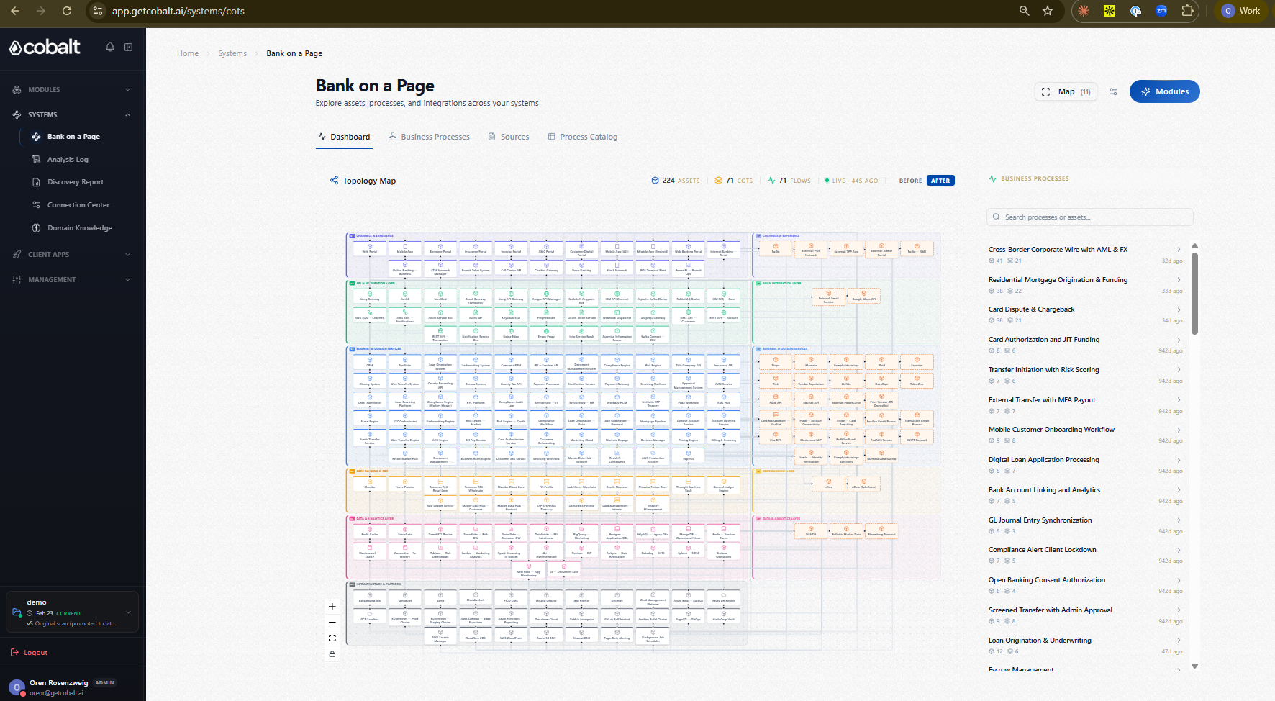
Notes:
This is a bank’s architecture, on one page. Everything you see here was discovered automatically by Cobalt, by scanning the bank’s systems.
"On the left we see the bank's topology map. Each block here is a system component such as a 3rd party application, a cloud service or an in-house developed system.
The components are arranged in layers according to their place in the IT stack, from channels and user experience on the top, all the way down to the core banking system, the data layer, and the infrastructure layer.
Internal components, appear on the left side of the map, and third-party services such as Stripe or Plaid, appear on the right
Each component is connected by wires to all the other components that it communicates with.
On the right-hand side we see the list of business processes discovered by Cobalt. Here we have for example cross-border wire transfer and mortgage origination. These are just two out of hundreds or thousands of processes that you will find in your bank
Generating this view would have taken months for an Enterprise architecture team. Cobalt produces this in minutes.

Slide 7
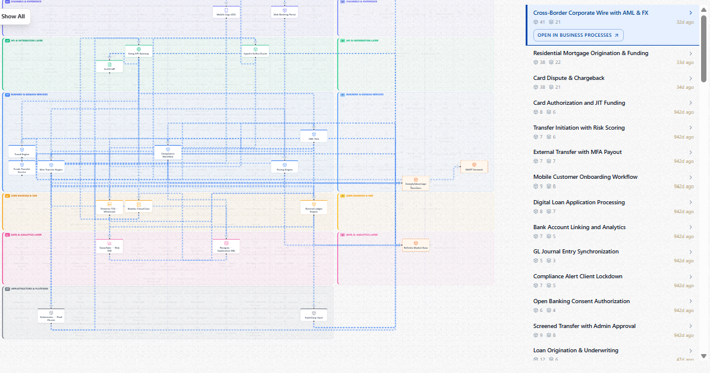
Notes:
But now comes the real magic. When I click on any business process, a path lights up on the topology map, and I can immediately see all of the different components that the business process uses.
This wire transfer, for example, uses 20 different components, from the mobile app through the Fraud Engine to the core banking system. This visibility alone can reduce incident resolution time by an order of magnitude.

Slide 8
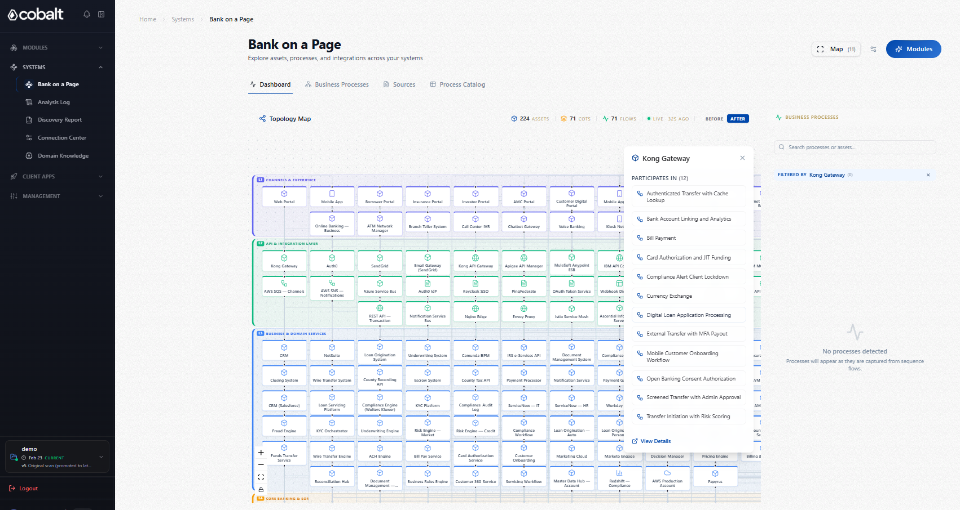
Notes:
And it works the other way too. Here I click on Kong Gateway, and immediately I see a list of all the business processes that use this component, and could be affected if it changes.
But when an architect plans to make a change, he or she needs even more details. Let's deep dive into one of the business processes.

Slide 9
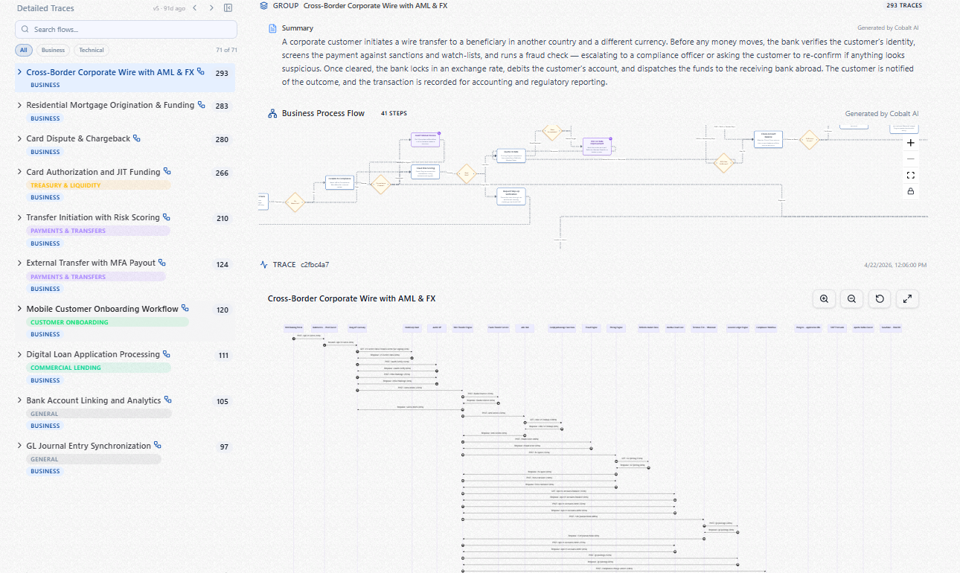
Notes:
I’m Going back to the cross border wire transfer from before –
Here I see the summary that Cobalt produced for this business process in plain English.
Underneath the summary there is a process flow diagram, that covers the entire process, end to end, showing the business logic of each step.
But Cobalt isn't just a discovery tool. Cobalt can help you plan any change based on its complete understanding of the existing architecture using a chat interface

Slide 10
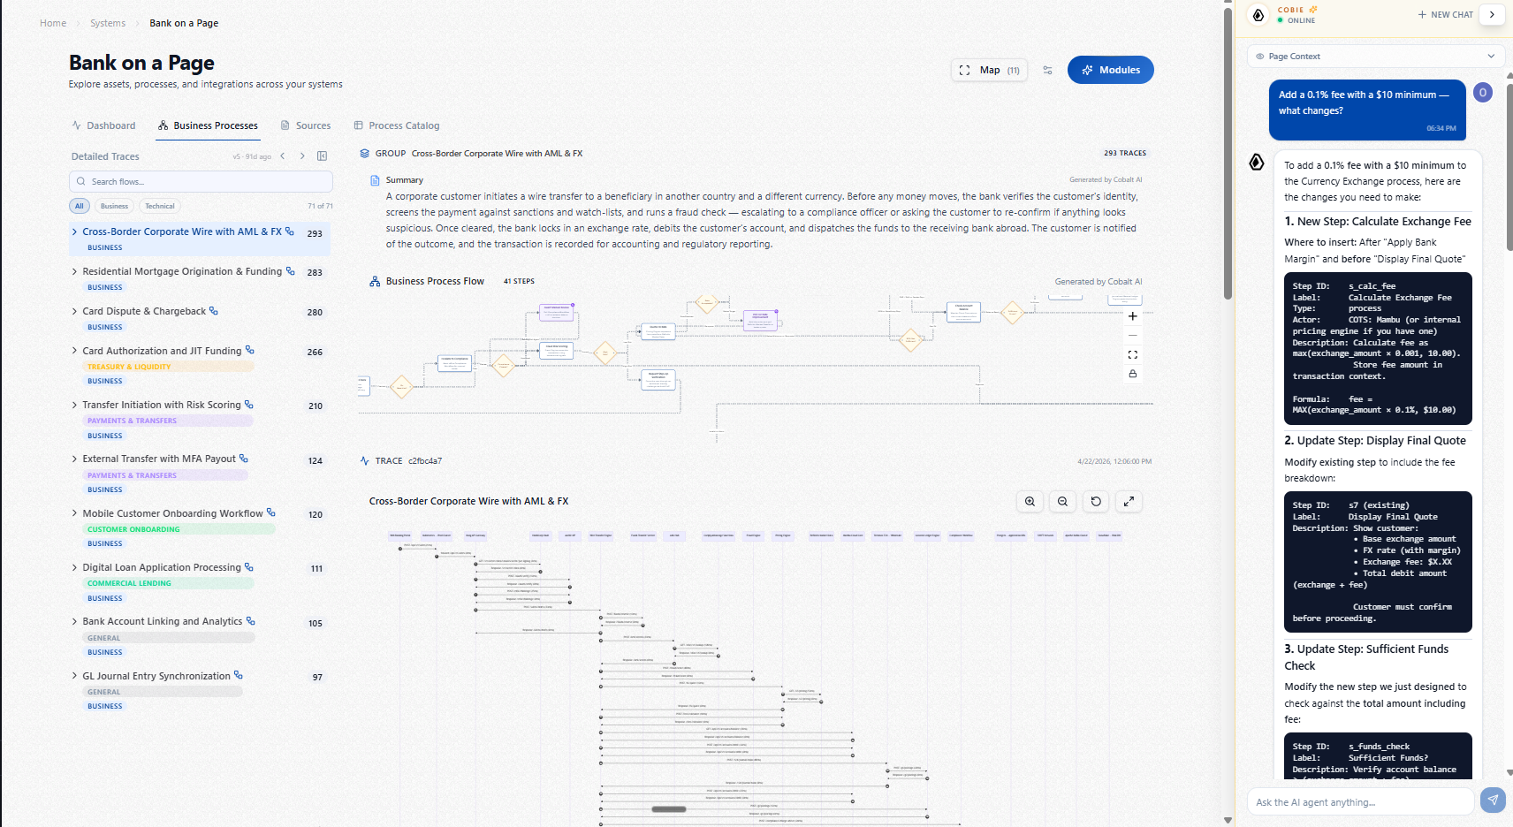
Notes:
So I'm opening Cobie – our agentic architect and ask Cobie: “how do I add a fee to the wire transfer process?”
Cobie suggests what steps to add to the process, How to implement and test them across the different systems, and even the regulatory considerations that I need to take into account.
That analysis would have taken weeks of interviews with multiple teams. Cobalt does it immediately

Slide 11

ALSO IN SCOPE
Incident response, and DORA
The same map serves more than transformation. It's also how you cut incident triage, and it's what DORA now requires by law.
"Financial entities shall identify all information assets and ICT assets, and shall map those considered critical. They shall map the configuration of the information assets and ICT assets and the links and interdependencies between them."
DORA Article 8(4) | EU Regulation 2022/2554, in force since January 2025
Notes:
One more thing before I wrap up.
Modernization is the use case I've shown you, but it's not the only one that this mapping serves.
Incident response is another obvious use case.
Industry data shows 60 to 80% of mean time to resolution is investigation, not the fix. The map you just saw becomes the brain for the investigation, and triage can drop from hours to minutes.
There is also a regulatory aspect to this, as you know DORA, came into force in January 2025. Article 8(4) requires banks to identify all information and ICT assets, map the critical ones, and map the configuration and interdependencies between them. That is, almost word for word, the output spec of Cobalt. We produce that map automatically.
אם יש זמן ....
And Article 19's reporting clock, 4 hours to initial notification, 72 hours to intermediate, 1 month to final, makes the speed of incident triage a compliance question, not just an operations question.

Slide 12


From Investigation to Instant Visibility
Visible
Connected
Actionable
Trusted
How the organization actually operates
End-to-end view across all business processes
Confident decisions backed by blast radius data
Continuously updated, not point-in-time snapshots
Real runtime interactions, not diagrams
Cross-system dependency mapping
Instant impact analysis for every change
Multi-source, traceable, validated by runtime data
It's no longer something you investigate. It's something you see.
Notes:
To recap.
The reason bank transformation is slower than it should be is visibility. You cannot execute on what you cannot see.
If you're a CIO, a CTO, or an enterprise architect with a modernization program that's stuck, or one you can't quite start, I’ll be here all day , and I’m happy to talk to you
Thank you

Slide 13
Thank You
Notes:
[Q&A, 2 min]
Likely questions and short answers:
Q: How long to stand up Cobalt at a bank?
A: First architectural view in 2 to 4 weeks. We're read-only and metadata-only, so security review is fast.
Q: What sources do you need?
A: Whatever you have. Source repos, CMDB, telemetry, API gateways, logs. The more sources, the higher the confidence. We don't require any single one.
Q: How is this different from process mining or APM?
A: Process mining sees event logs but not architecture. APM sees runtime traffic but not business meaning. Cobalt links code-level structure to business processes. That's the gap.
Q: Does it work on mainframe and COBOL?
A: Yes. That's actually one of our strongest use cases. We parse COBOL, JCL, DB2, copybooks.
Q: Pricing?
A: Per-environment. Happy to walk through after.
Q: Does Cobalt help with DORA compliance?
A: Yes. Article 8(4) requires banks to map all ICT assets and their interdependencies. That is what Cobalt produces by default. Article 19's reporting clocks (4 hours, 72 hours, 1 month) raise the cost of slow triage, which is the second use case for the same map.

Slide 14
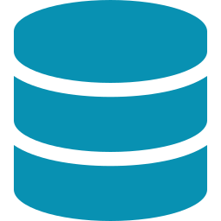
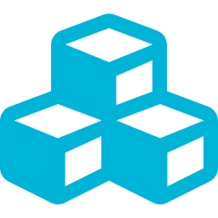


How Cobalt Delivers This
Sources
Cobalt Engine
Outputs
Code / Logs / CMDB /
Telemetry / APIs / Docs
Semantic Crawler
Business processes
Dependencies
Blast radius / Impact
No agents installed | No credentials required | Read-only access | Metadata only | No changes to production

